Slide 1


Price Model
Presented by :
Amaury van Kesteren
Jacques Declercq
Jayesh Italiya
Michel Ombessa

Slide 2
Table of Content
Immo-Eliza - Price Model
Goal & Project Summary
Data Analysis
Feature Engineering
Data Visualizations
Prediction Scores
Conclusion

Slide 3






Goal : Create a machine learning model to predict prices on Belgian property sales.

Slide 4

Project Summary
+ 10k properties data set .
Find features influencing prices.
Clean & engineer the data for ML.
Run predictions
Visualise the data with graphics.

Slide 5
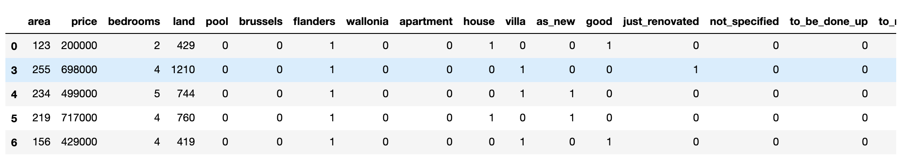
Data Analysis
GOAL :
Create a machine learning model to predict prices on Belgium’s property sales.
Feature Engineering
Modify the categorical values to numerical so its visualisable & readable to the model.
Subtype of property, region, state of the property*.
House : 5771, Villa : 1027, Apartment 234
Remove rows with missing values & convert data types.
* For state of the property we used : Ordered Scaling

Slide 6
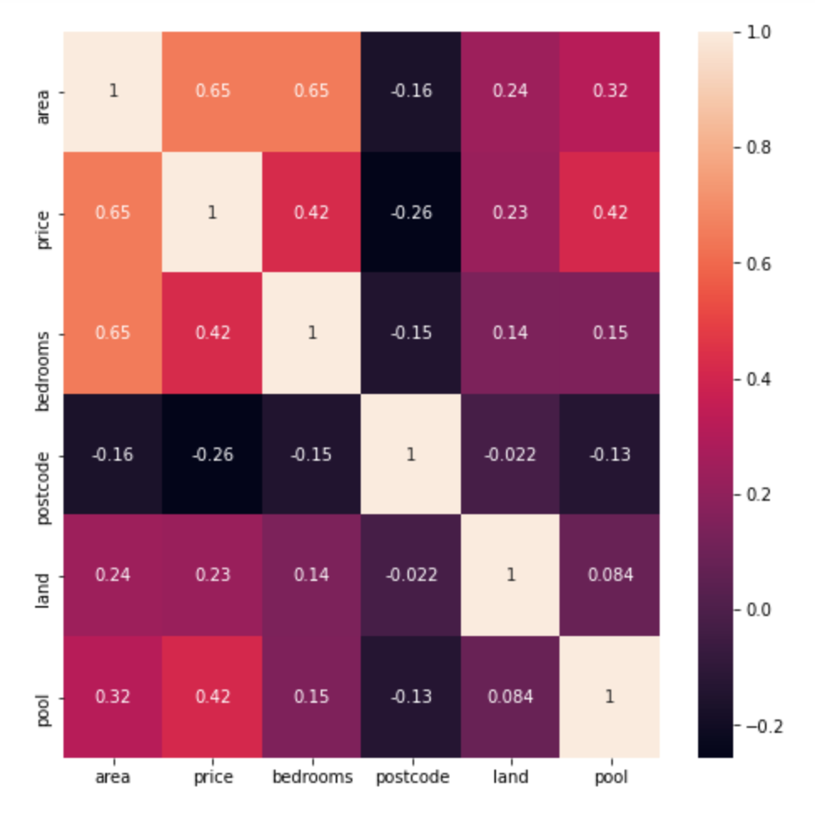
Data Analysis
GOAL :
Create a machine learning model to predict prices on Belgium’s property sales.
Data Visualisation : Heatmap*
- Shows which variables are correlated,
to a certain degree.
- Removed features that are highly correlated or categorical.
- area (m2) & number of bedrooms
*We based us on numerical values and not on the categorical values for final predictions scoring & evaluations

Slide 7


Prediction Score
Model : Polynomial & (Multiple) Linear
Every features taken into account (Polynomial) :
68% (Training Set – 80% of the data)
70% (Test Set – 20% of the data)
Area & Bedrooms (Linear)
41% (Training Set – 80% of the data)
49% (Test Set – 20% of the data)

Slide 8
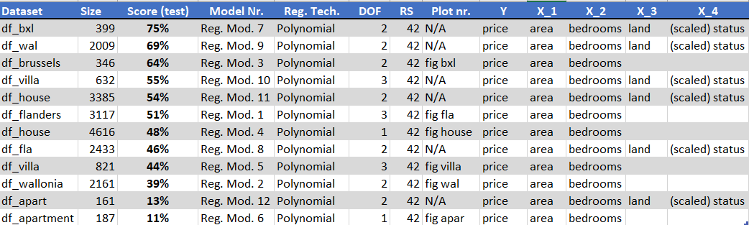
Prediction Score
Model : Polynomial & (Multiple) Linear
Subsets (Region, Subtype property)

Slide 9
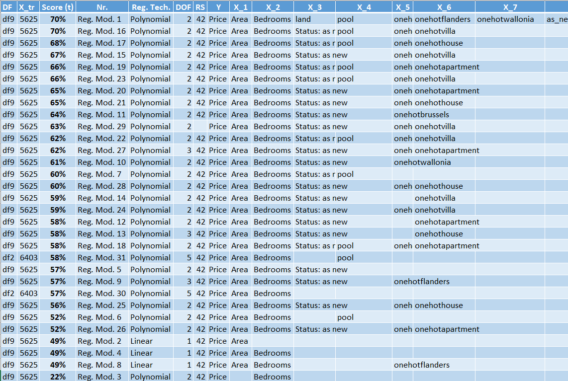
Prediction Scores

Slide 10
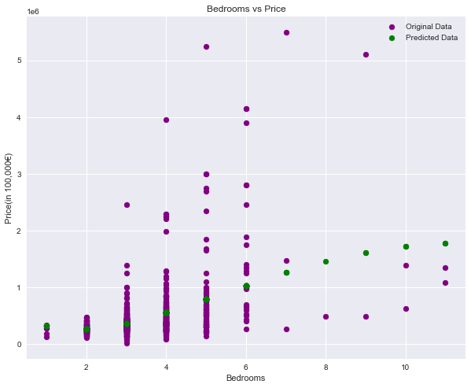

Price predictions based on nr of Bedrooms
Interesting
Based only on nr of bedrooms
Our prediction isn’t accurate.
Prediction Score :
22%
DOF : 5

Slide 11
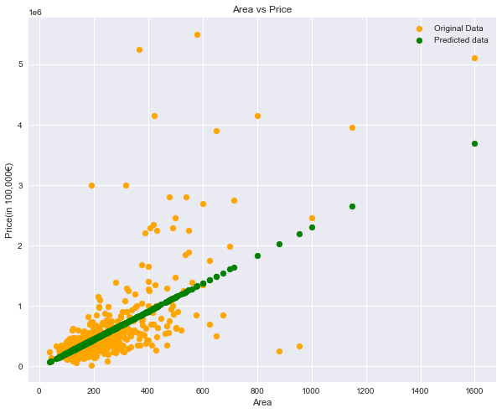
Price predictions based on Area
Prediction Score :
45%
DOF : 1

Slide 12
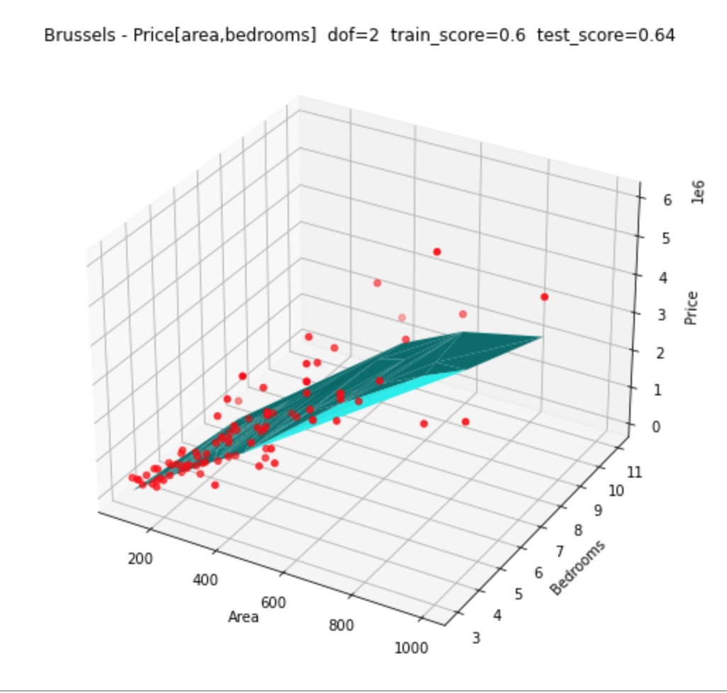
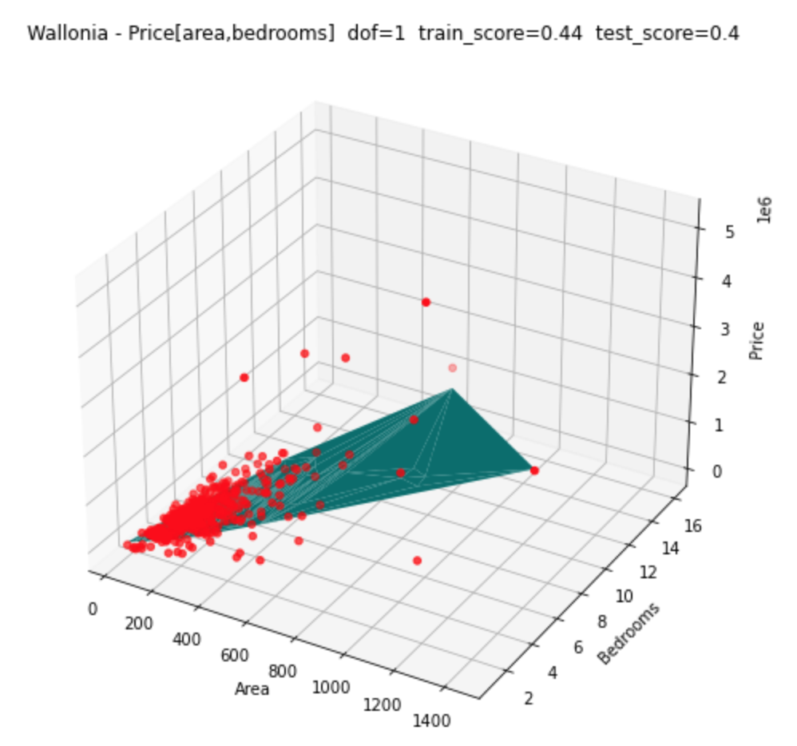
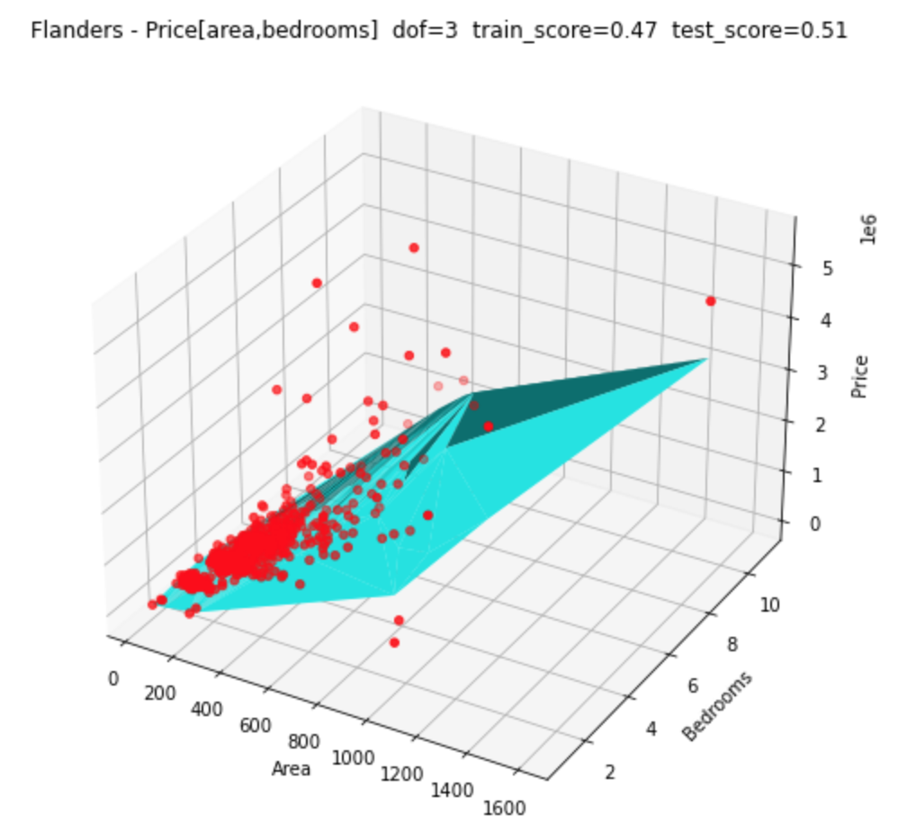
Data Visualizations
GOAL :
Create a machine learning model to predict prices on Belgium’s property sales.
3 Subsets per Region : Flanders, Wallonia & Brussels
Interesting
We score higher in Bxl :
Less outliers and diversity in properties
helps for a secure prediction.

Slide 13
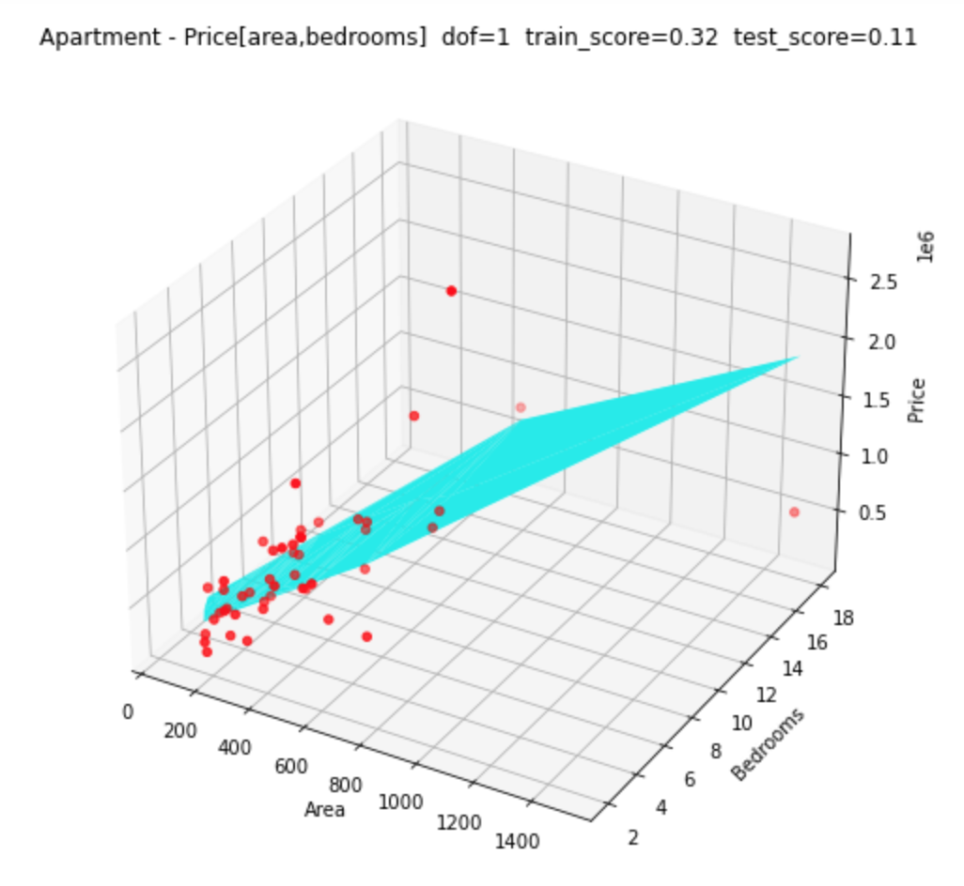
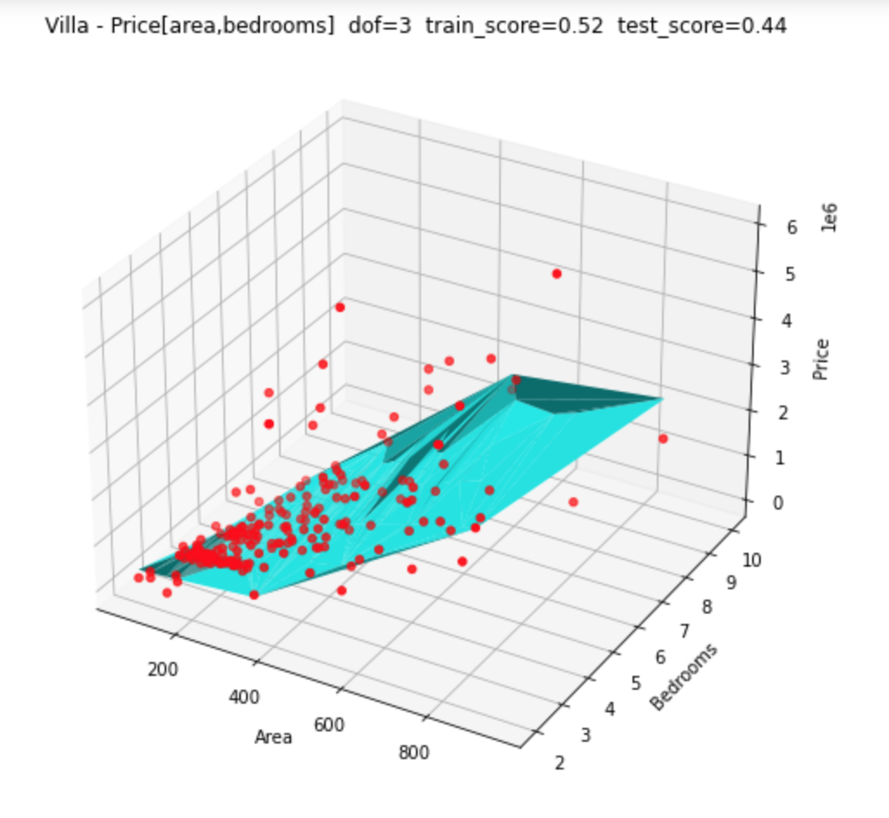
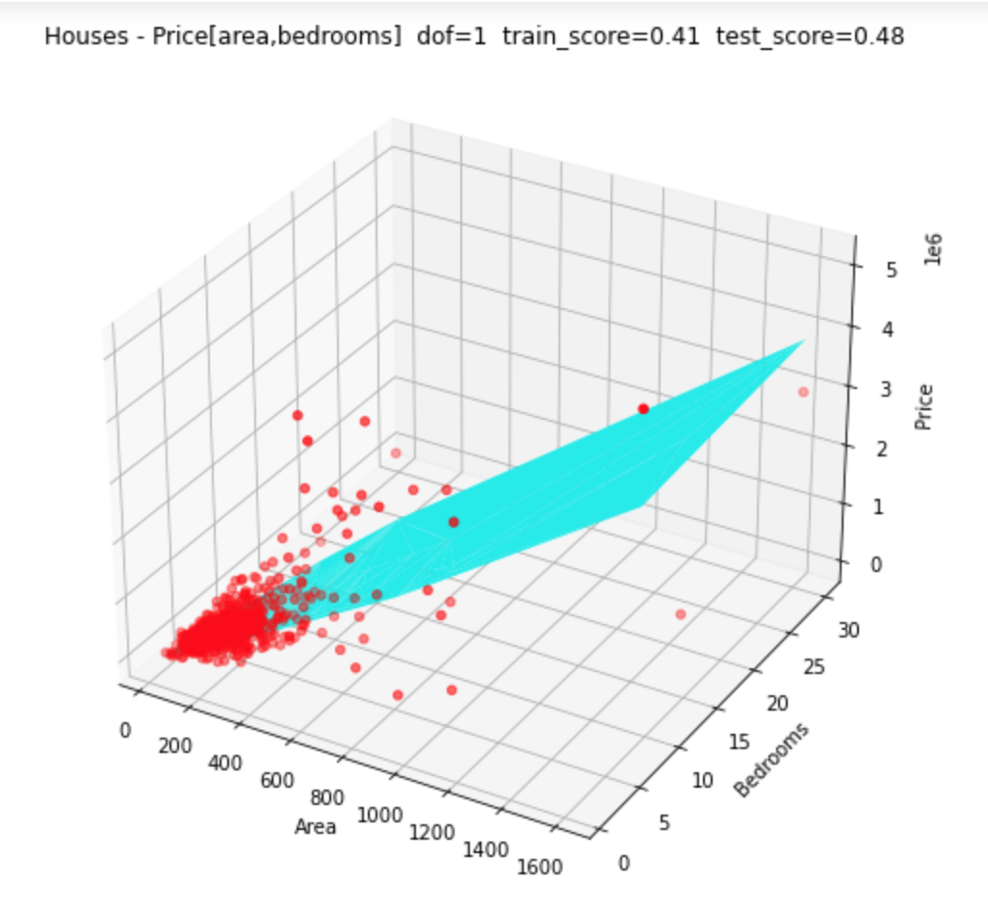
Data Visualisation
GOAL :
Create a machine learning model to predict prices on Belgium’s property sales.
3 Subsets per Subtype : Houses, Villa & Apartment
Interesting
We score lower with apartments :
Trough all regions apartment have more
outliers and variety in values.
Small Datapoints (234 apartments)

Slide 14
Conclusions
Price, area, nr of bedrooms, state of the building and region is very price influencing.
We reach a score of 70% with categorical values. And almost 50% with numerical values (bedroom, area)

Slide 15
THANK YOU

